Slide 1



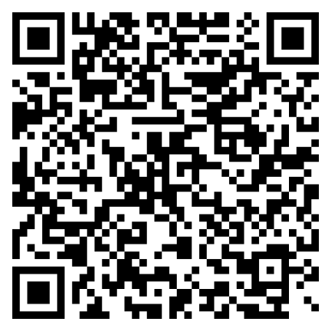

Parent Café
Mother’s & Memories
Please Join Us
Thursday May 09, 2024
2:00 pm to 4:00 pm
Hosted By
Texas City Moore Memorial Library
1701 9th Avenue North
Texas City, TC 77590
To register Click on the QR Code Below, We look forward to seeing you
Children are Seeds
Roots are Memories
1-888-507-6681

